Slide 1




HOSTED BY:
SUPPORTED BY:

Slide 2




Paper No. 183403
New Economical Process to Monetize High-CO₂Natural Gas
Ahmed M. Shahin, Ph.D., Canada Chemical Corporation
Conrad Ayasse, PhD, FCIC, Canada Chemical Corporation
Alan Ayasse, MSc., PEng, Canada Chemical Corporation
Rob Ayasse, MscEcon (IR), EMBA, Verdis Synfuels

Slide 3
Target high-CO₂ natural gas
Produced gas pressure is
greater than 1070 psia

Slide 4
CO₂ Removal Alternatives
Traditional amine processes-
Dilute amine solutions-high energy costs to flash a lot of water
Chemical consumption
Corrosive
Low pressure CO₂: high compression costs
Cryogenic processes-
Produces liquid CO₂
High energy costs for cooling and regeneration of the natural gas
Solid CO₂ causes blockage of equipment
Cryogenic fluids are toxic and flammable

Slide 5
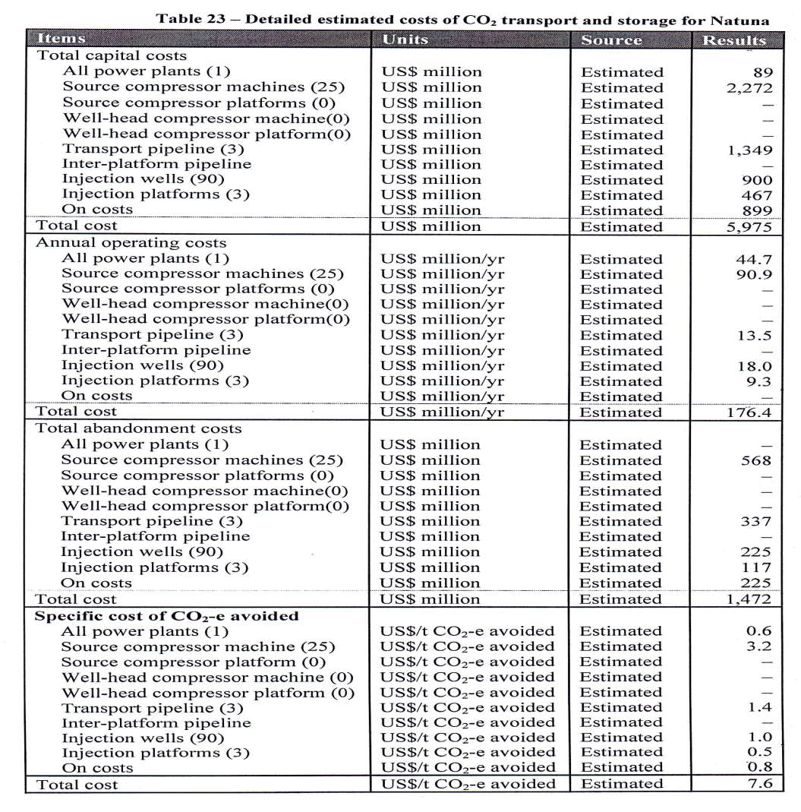
Estimated costs of CO₂ transport and storage for Natuna^{3,} ⁴
(Formation at 5715 psi)
Gas compression capital cost is USD2.272 Billion, 38% of total capital.
Compression operating cost is USD90 Million/y,
51% of total operating cost
³Assessment of the capture and storage potential of CO₂ co-produced with natural gas in South-East Asia, May, 2010. Asia-Pacific Economic Cooperation, APEC Energy Working Group

Slide 6
Dry CO₂ Absorption Concept
Absorbent is a packed bed
containing porous solid particles
having
absorbent polymerized inside the pores

Slide 7
Absorbent Polymer¹
An active amine adduct is formed
within the pores by reacting
a polyamine and hydrophillic polyol
crosslinked with an aldehyde
to form a thermally stable absorbent.

Slide 8
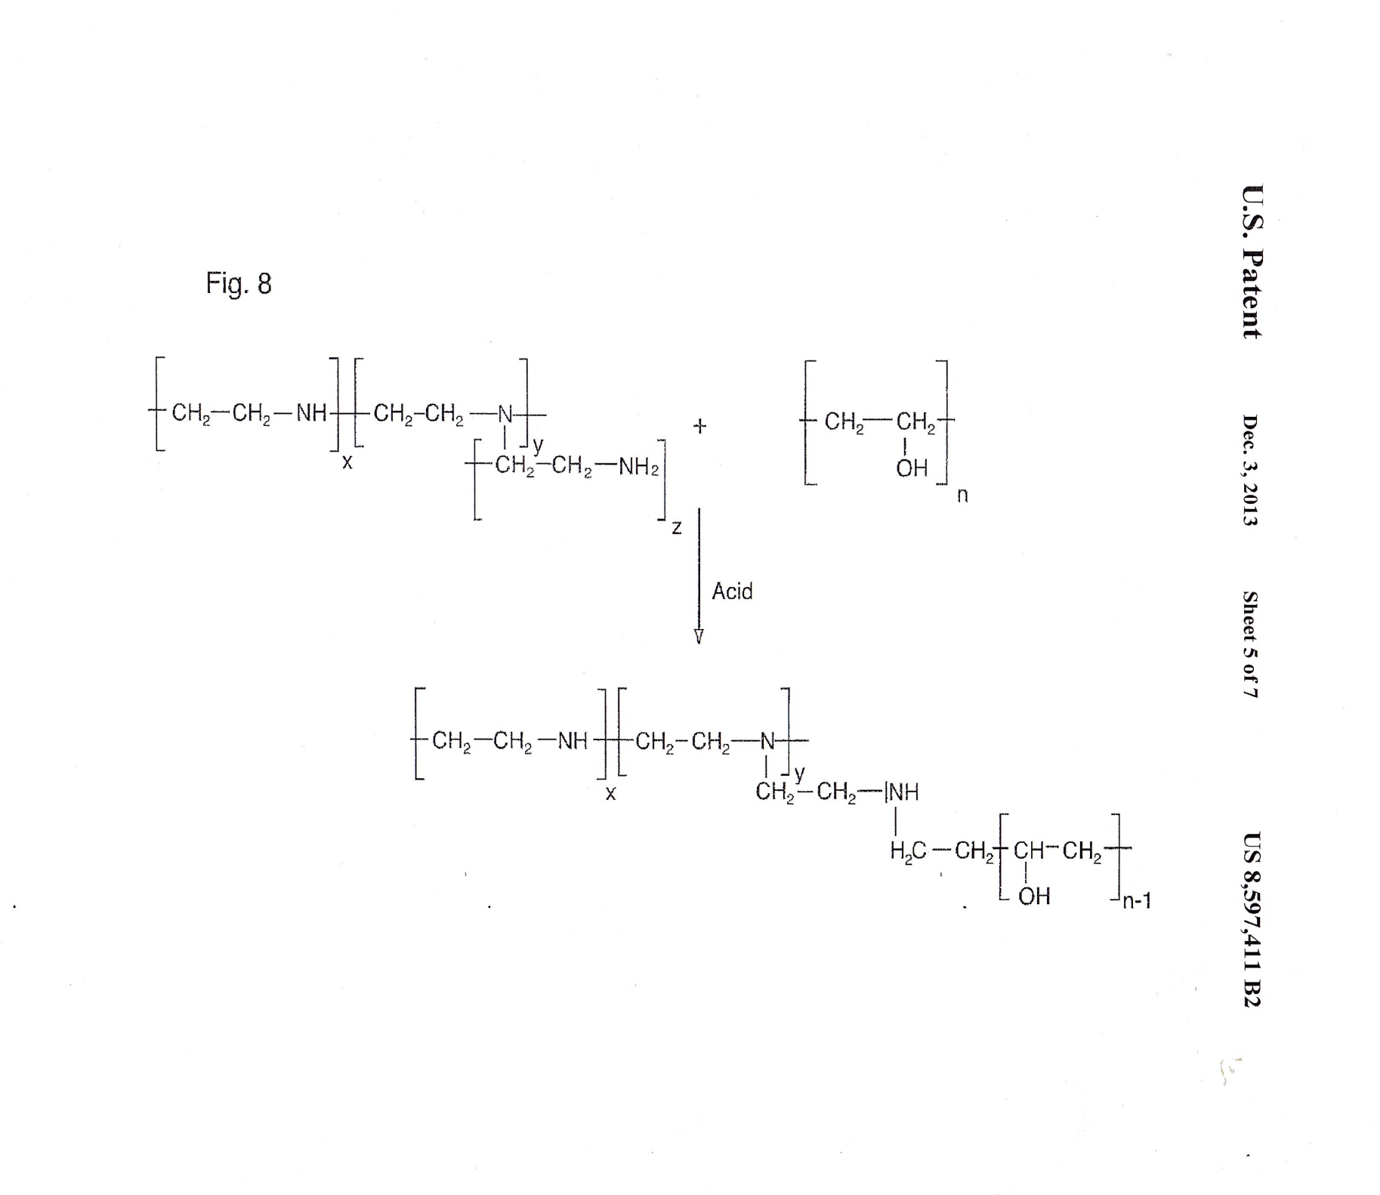
The Reaction Of Polyethyleneimine With Polyvinylalcohol in the Presence of Acetic Acid
PEI, MW 1300 AMU
PVA, MW 85,000-124,000 AMU
SPAA
Solid polyamine
Reactive secondary or tertiary amines react with CO₂
Bonds to support surface
Paper #183123 • H2S Removal & Conversion to Elemental Sulfur • Dr. Conrad Ayasse

Slide 9
Silica Absorbent Supports
Support | Aerolyst 3038 | Aerolyst 3046
Basic compound | Aerosil 380 | Aerosil 380
Shape | Extrudates | Rings
Diameter, mm | 2.5 | OD 4.7, ID 2.0
Surface area, m²/g | 270 | 180
Pore volume, ml/g | 0.9-1.0 | 0.8-0.9
Tapped density, g/l | 400-460 | 340-400
Si content | 99.8 | 99.8

Slide 10
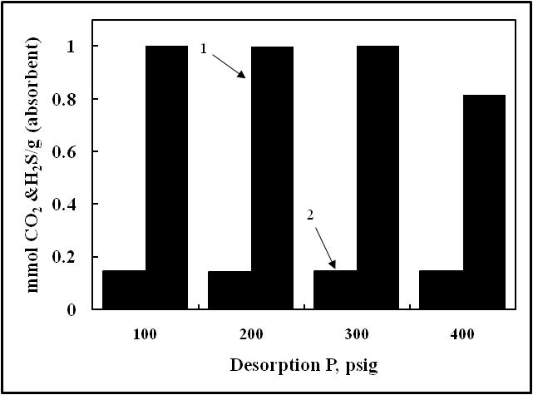
CO₂ Stripping at Elevated Pressure
CO₂
H₂S

Slide 11
Elevated CO₂ Stripping Temperature
CO₂ absorbed from a gas stream at 100 psig (21 ºC.)
Is fully recovered at
300 psig (130 ºC.)

Slide 12
CO₂ Absorption Capacity
Feed gas 24.4 % CO₂ in nitrogen

Slide 13
Alternative CO₂ Stripping Pressures
Desorption pressure less than Absorption pressure
Desorption pressure equal to Absorption pressure
Desorption pressure greater than Absorption pressure

Slide 14
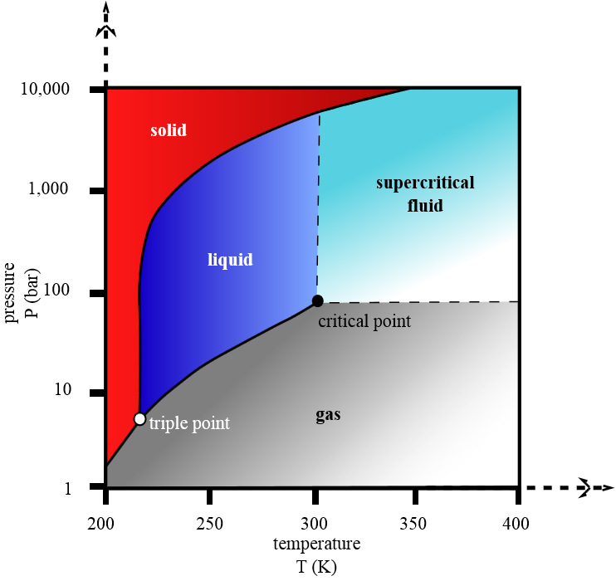
CO₂ Phase Diagram
Critical Point:
73.77 bar (31 ºC.)
7377 kPa (1070 psia)

Slide 15
CO₂ phase changes
Heating liquid CO₂ and increasing its pressure converts it to a SUPERCRITICAL state: density is like a liquid and viscosity is like a gas. Cooling below the critical temperature converts it back to a liquid.

Slide 16
How Does Our CO₂ Recovery Plant Work?
Our process exploits the ability of our absorbent to strip CO₂ at pressures above 1070 psia
and
exploits phase behaviour of CO₂
to
provide an economical recovery of CO₂ directly as a liquid

Slide 17
Plant Starting Conditions
Back-
Pressure
Regulator (>1070 psia)
Cool CO₂ (<31 ºC.)
Hot CO₂ (130 ºC.)
Heater
Pump
Liquid
CO₂
(<31 ºC.)
Cooler
This is the starting configuration (Connections from Absorber 2 to CO₂ vessels are not shown).
Absorber 1 is saturated with CO₂ and Absorber 2 has begun treating Raw Gas.
Absorber 1
Raw Gas
Clean
Gas
Absorber 2

Slide 18
Removing Raw Gas
Back-
Pressure
Regulator (>1070 psia)
Cool CO₂ (<31 ºC.)
Hot CO₂ (130 ºC.)
Heater
Pump
Liquid
CO₂
(<31 ºC.)
Cooler
Absorber 1
Raw Gas is swept from the free space of Absorber 1 with pure cool CO₂ and sent to Absorber 2 so that hydrocarbons do not contaminate the stored CO₂
Raw Gas
Clean
Gas
Absorber 2

Slide 19
Stripping CO₂
Back-
Pressure
Regulator (>1070 psia)
Cool CO₂ (<31 ºC.)
Hot CO₂ (130 ºC.)
Heater
Pump
Liquid
CO₂
(<31 ºC.)
Cooler
Some stored CO₂ is heated to the stripping temperature, 130 ºC, so that absorbed CO₂ will be released from the bed particles and recovered . This continues until the bed is low in absorbed CO₂.
Absorber 1
Raw Gas
Clean
Gas
Absorber 2

Slide 20
Flushing Hot Stripping Gas
Back-
Pressure
Regulator (>1070 psia)
Cool CO₂ (<31 ºC.)
Hot CO₂ (130 ºC.)
Heater
Pump
Liquid
CO₂
(<31 ºC.)
Cooler
The hot CO₂ in the free space between the particles is pushed into the cooler with Raw Gas in preparation for starting the absorption cycle on Absorber 1.
Absorber 1
Raw Gas
Clean
Gas
Absorber 2

Slide 21
Switching Absorbers
Back-
Pressure
Regulator (>1070 psia)
Cool CO₂ (<31 ºC.)
Hot CO₂ (130 ºC.)
Heater
Pump
Liquid
CO₂
(<31 ºC.)
Cooler
Absorber 2
The Raw Gas stream is re-directed to Absorber 1, and the CO₂ stripping cycle is begun on Absorber 2.
Raw Gas
Clean
Gas
Absorber 1

Slide 22
Conclusions
  Enables low-energy dry CO₂ recovery
  Operates as both physical and chemical absorbent
  Recovers CO₂ at pressure above absorption pressure
  Recovers CO₂ from high-pressure natural gas
  as a liquid without compression

Slide 23
Any Questions?
To Engage With Us Further:
www.canchem.ca
www.Verdisfuels.com
Paper #183403 • Monetize High CO2 Natural Gas • Dr. Conrad Ayasse

